Slide 1
Theories of Karl Marx
How are the theories of Marx, one of the most influential thinkers, relevant today ?

Slide 2
Introduction
Most famous works - Communist Manifesto and Das Kapital
Critic of capitalism - believes it to be inherently exploitative
Proletariat - good Bourgeoisie - evil
Capitalism responsible for the inequality in society
Profit is bad, as it is used by the capitalists for individualistic ends
In a capitalist society, workers are exploited and paid meagre wages

Slide 3
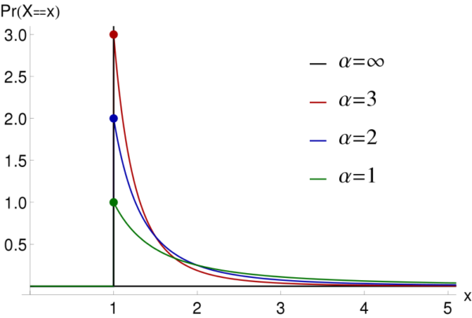
Matthew Effect and the Pareto Distribution
For to everyone who has, more will be given, and he will have abundance; but from him who has not, even what he has will be taken away.
Considered to be a natural law by some social scientists as well.
Thus capitalism cannot be blamed for unequal distribution of wealth.

Slide 4
Correlating ethicality and economic status ? It doesn’t get more wrong !!
Marx somehow believes that the proletariat is good and the bourgeoisie consists of people who are morally corrupt.
If the dictatorship of the proletariat is established, Marx overlooks the fact that the proletariats won’t be any less corrupt than the capitalists because of their sudden access to power.

Slide 5
Labour Theory of Value and Theory of Surplus Value
Commodity sold at higher price than the wages paid to workers, so the surplus reflects the exploitation by capitalist.
But, it was the capitalist who ensured that the labour of the workers was productive, by buying all the machinery, leasing the factory site, establishing a management structure etc. The capitalist took on a huge amount of risk (if the company goes bankrupt, it is the capitalist who has to incur the debt).

Slide 6
How to lie with Statistics...
There are three kinds of lies - lies, damned lies and statistics
Data compares the percentage of poor in one year with the percentage of poor in another year.
Most studies don’t track the poor in one year over the income ladder
They ignore the idea of income mobility
95% households that were poor in 1975, were no longer poor in 1991 - study by University of Michigan

Slide 7
Holodomor
to kill by starvation
Ukrainian Genocide of 1932-1933
Death toll estimates - 3.5 million to 12 million
A result of Stalin’s calamitous socio-economic policies (in order to realize his dream of a proletarian, socialist nation) which resulted in the physical destructions of broad sections of its population.

Slide 8
Capitalism is not without flaws
But if we are looking for alternatives, realize that communism might not be the best choice.
Objective : minimize exploitation, so increased political regulation, giving up one’s liberty and freedom and transferring power from the people to the state is not the way to go.

Slide 9
“Democracy is the worst form of government except for all the others”
- Winston Churchill

Slide 10
In other words, capitalism is the worst economic and political system except for all the others.

